Slide 1
TEAM CONNECT CUSTOM JAVA RULES
Team Connect 6.x

Slide 2
Agenda
What is a Rule?
Basic components
Different types and triggers
GUI Rules
Team Connect API

Slide 3
Agenda
TeamConnect API Basics:
API Packages
Types of classes
Logging
Rules Classes
Java Class exercises
Notes:
int note: Mention either here or in the section later where you go into API that you would use the same API to develop custom rules, to create CJBs, and to define the functionality in custom tools

Slide 4
WHAT IS A RULE?

Slide 5
What is a Rule?
Rules enable TeamConnect to automatically perform validations, security checks, and approval processes that control the flow of data in TeamConnect.
Examples:
Do not allow a project record to be deleted by a certain group of users unless the record is in a particular phase.
Do not allow users to post invoices over a certain amount until approval is obtained.

Slide 6
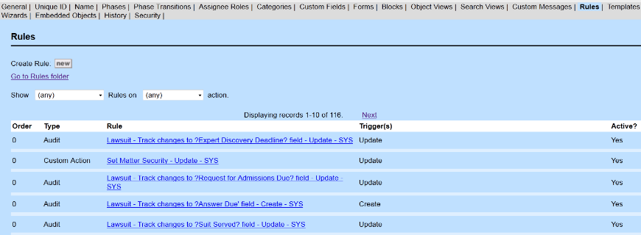
What is a Rule?
System objects and custom objects all have a Rules tab
Here is where rules are listed by type, name of rule, trigger(s), and if they are active or not
Notes:
Show the different types of rules or all rules
Also can show the types of actions the rules are triggered on: Create, Update, Delete, Phase Change, User Invoke.
This can be overviewed briefly, but for the full 5 day course will be much more detailed.
Exercises will include creating rules for each rule type on the trainees custom object

Slide 7
Rules – Components
All rules have three parts
Trigger
The event that cause the rule to fire
Qualifier
The specific conditions of a record checked before executing the rule action
Action
What the rule does when the rule is triggered and the qualifiers are equal to true

Slide 8
Rule Triggers
Rules can be triggered by various events which can occur within Team Connect.
Create: A new record is created
Update: An existing record is changed
Delete: An existing record is marked to be deleted
Phase Change: The Phase of a record is changed
Post: An Invoice is posted for payment
Activate/Deactivate: An Account status is changed
User Invoke: Triggered manually by user

Slide 9
Rule Types in the order they are Executed
Security: Protect record in certain state
Example:
If a user opens a record in a certain phase, he shouldn’t be able to modify it if he does not belong to a certain group
Pre-Population: Populate fields or sub-objects with values predefined in a template
Examples:
Populate fields of existing records
Create a new record and populate its fields

Slide 10
Rule Types
Validation: Verify conditions before allowing an operation.
Examples:
Validate field population before saving
Validate correct date before posting a Task
Approval: Send requests for approval to users/groups before an action is completed.
Examples:
Approve record phase change
Approve invoice posting

Slide 11
Rule Types
Custom Action: Perform custom actions according to the needs of the business
Examples:
Create a History record every time a Task is posted
Create an Account, a Task and a History record when creating a Matter
Scheduled Action: Similar to custom actions but run at scheduled times determined by the users.
Example:
When a condition is met, for the next 3 days send an email every 2 hours to remind the users to do something.

Slide 12
Rule Types
Audit: Track activity in TeamConnect by logging information in History records
Example:
When a user updates a field in a record, create a History recording the old and new values.
Post-Commit: After confirmation of record save to the database, trigger an action
Example:
When the database server confirms that an invoice has been posted for payment, send the Vendor an email notification.

Slide 13
Rule Types – Other Types
Page Transition: Triggered when a user moves to a different page in a Wizard.
Created within wizard definition
Similar to Custom rules
Created to govern user input
Triggered when the user clicks the next button
Used mainly as Validation rules

Slide 14
Rule Types
The following rules are usually defined in the GUI by Business Analysts:
Security
Pre-Population
Validation
Approval
Audit
Post Commit

Slide 15
Rule Types
The following rules are written by Developers :
Custom rules
Scheduled Actions
Note: These rules are written using Java or JavaScript. This presentation will focus only on Java development.

Slide 16
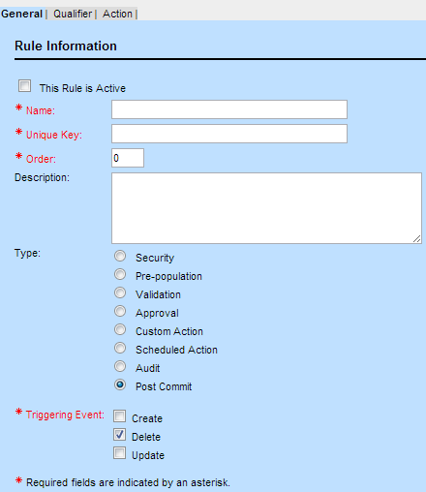
Rules – How is a rule defined?
General Information: Description, Type, Trigger, Unique Key
Qualifier and Action cannot be set until you save the rule definition with a Type, Trigger and
required fields

Slide 17
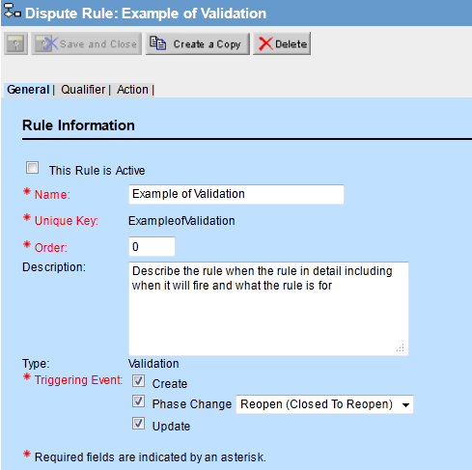
Rules – How is a rule defined?
Activate the rule ONLY after it has been fully defined and is ready for testing
Name the rule for organization
Describe the rule in detail
Select all applicable triggering events
Note: If the rule applies to several (but not all) phase changes, then copy the rule to create a new rule with the same definition for each necessary phase change

Slide 18
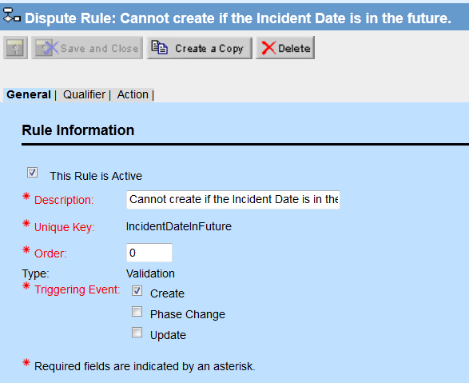
Rules – How is a rule defined?
General Information: Description, Type, Trigger, Unique Key
The activation of the rule should be done when the rule is completed
Example: Prevents a new Dispute record from being created if the Incident Date (a custom field) is in the future.

Slide 19
Rules – Qualifiers
When the triggering event occurs, the qualifiers explain what conditions must exist for the rule’s action to occur
Qualifiers can be related to the users of the system or the object records
Examples of qualifiers might include checking for a specific user group, category, main assignee, or numeric value

Slide 20
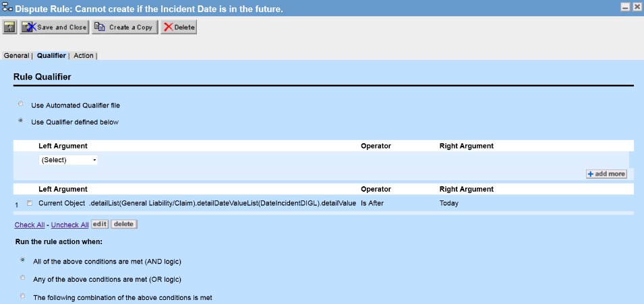
Rules – How is a rule defined?
Qualifier: Is Incident Date in the future?
Example: Prevents a new Dispute record from being created if the Incident Date (a custom field) is in the future.

Slide 21
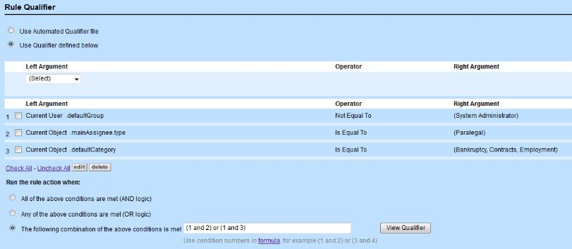
Rules – Qualifiers and Conditional Logic
The example below shows qualifying conditions where the current user is not in the system administrator group and either has a main assignee with the role paralegal or has a default category equal to bankruptcy, contracts, or employment

Slide 22
Rules – Actions
Depending on the rule type, different actions are available
Many actions are just a message that explains why the user cannot perform an action
Other actions include data entry templates, approval workflow routes, email notifications, automated actions, and audit history record generation

Slide 23
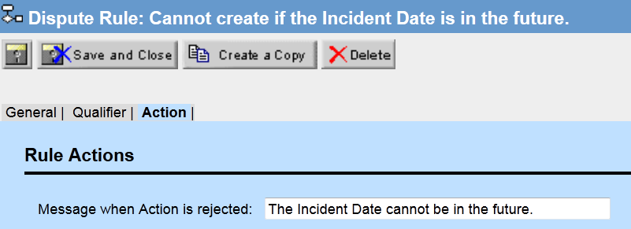
Rules – How is a rule defined?
Action: Display message to user
Example: Prevents a new Dispute record from being created if the Incident Date (a custom field) is in the future, and display a message explaining why the creation was prevented.

Slide 24
GUI RULES OVERVIEW

Slide 25
Security Rules

Slide 26
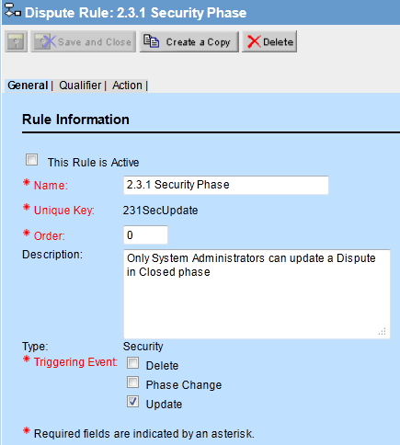
Rules – Security
Security rules can be triggered on update and delete
Also on post or void depending on the object
Security rule that will not allow
users to update a record in the
closed phase unless they are in
the System Admin group
The rule is not active yet
Name the rule and describe it
The triggering event is update
Notes:
The qualifier is describing the condition when this rule should fire.
Create a let argument, sometime the navigator is needed, then use the operator like is or is not, then equal to, populated, and not populated.
Then signify the right argument
Several qualifiers can be used, and the there is and, or, as well as and/or logic involved.
Automated Qualifier files are uploaded here too.
Rule Actions show a message to the user when this rule is triggered.

Slide 27
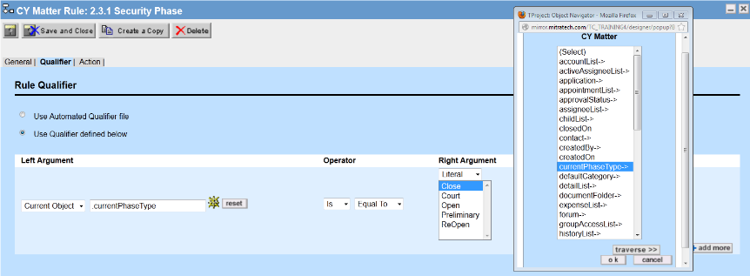
Rules – Security
Administrators define the rule’s qualifiers using left and right arguments containing hardcoded values or field references (GUI Rules)
All rules can also use custom coded Automated Qualifiers uploaded into TeamConnect (Java Rules)
This example below requires that the current record’s Phase Type is equal to “Close”
Notes:
The qualifier is describing the condition when this rule should fire.
Create a let argument, sometime the navigator is needed, then use the operator like is or is not, then equal to, populated, and not populated.
Then signify the right argument
Several qualifiers can be used, and the there is and, or, as well as and/or logic involved.
Automated Qualifier files are uploaded here too.
Rule Actions show a message to the user when this rule is triggered.

Slide 28
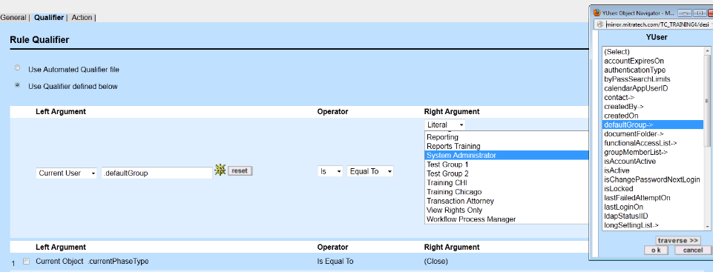

Rules – Security
A second qualifier checks if the user’s defaultGroup is not the System Admin group
Notes:
The qualifier is describing the condition when this rule should fire.
Create a let argument, sometime the navigator is needed, then use the operator like is or is not, then equal to, populated, and not populated.
Then signify the right argument
Several qualifiers can be used, and the there is and, or, as well as and/or logic involved.
Automated Qualifier files are uploaded here too.
Rule Actions show a message to the user when this rule is triggered.

Slide 29
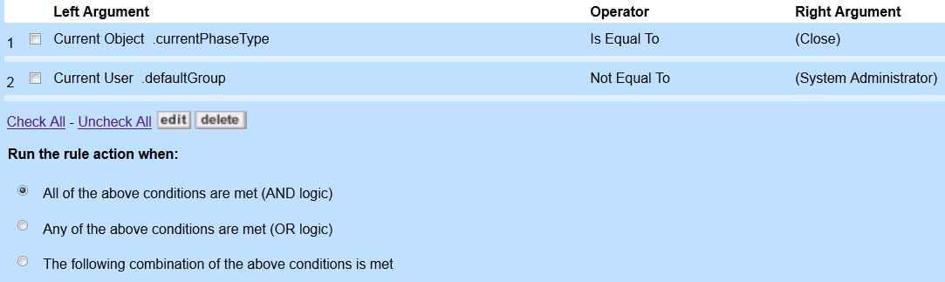
Rules – Security
The bottom of the qualifier page reflects both arguments
Administrators then have the option to use AND logic where all qualifiers must be met, OR logic where any of the qualifiers could be met, as well as a third option where the administrator defines the AND/OR logic in a combination format
Notes:
The qualifier is describing the condition when this rule should fire.
Create a let argument, sometime the navigator is needed, then use the operator like is or is not, then equal to, populated, and not populated.
Then signify the right argument
Several qualifiers can be used, and the there is and, or, as well as and/or logic involved.
Automated Qualifier files are uploaded here too.
Rule Actions show a message to the user when this rule is triggered.

Slide 30
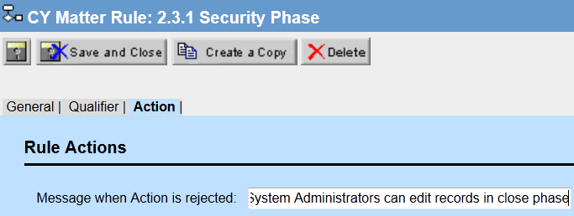
Rules – Security
The Action tab for security rules allows the administrator to create a custom message like the one below: “Only System Administrators can edit records in Close phase”
Notes:
The qualifier is describing the condition when this rule should fire.
Create a let argument, sometime the navigator is needed, then use the operator like is or is not, then equal to, populated, and not populated.
Then signify the right argument
Several qualifiers can be used, and the there is and, or, as well as and/or logic involved.
Automated Qualifier files are uploaded here too.
Rule Actions show a message to the user when this rule is triggered.

Slide 31
Exercise – Security Rules
Create a security phase that says only members of the training group can update records in the closed phase
Try to update this object record with a user in the correct group and a user in a different group to test it
Also, test this in any other phase to make sure it is only triggered in the correct phase
Notes:
The qualifier is describing the condition when this rule should fire.
Create a let argument, sometime the navigator is needed, then use the operator like is or is not, then equal to, populated, and not populated.
Then signify the right argument
Several qualifiers can be used, and the there is and, or, as well as and/or logic involved.
Automated Qualifier files are uploaded here too.
Rule Actions show a message to the user when this rule is triggered.

Slide 32
Object Navigator

Slide 33
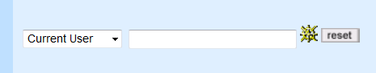
Rules – Object Navigator
The Object Navigator is used in several places in the designer
The Object Navigator is used extensively in the qualifiers for a rule
When you see icon of the ship’s wheel, the object navigator is available

Slide 34
Rules – Object Navigator
The Object Navigator is a tool that allows admin users to select desired fields through their attributes as defined in the object definition
These attributes and fields are located in the TeamConnect database tables known as the Object Model
The Object navigator allows admin users to traverse through object tables via a linked path to find specific fields or field options

Slide 35
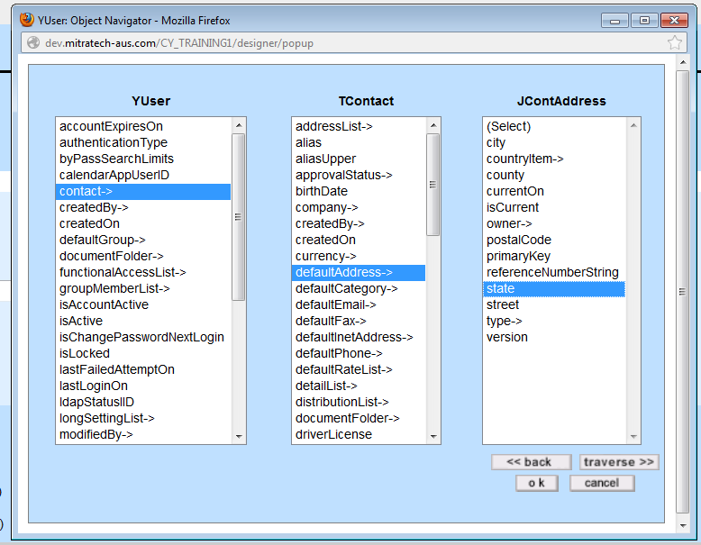
Rules – Object Navigator
To create a path to a field or group of fields, you will select one attribute from the tables you traverse
This is an example of how to get to the address State field for the current user
Starting from the User table, traverse to the User’s contact, then the contact’s default address, and then the state field of that address

Slide 36
Rules – Object Navigator
There are 3 different types of Attributes in the Object Navigator
Attributes
Bridges
Bridge Attributes
Attributes – Identify data values and indicate the end of the path, which means they cannot be traversed
No arrow (->) next to the attribute
Bridge – Form relationships between tables, bridging or linking one table to another or one object to another
Bridges will have and arrow next to the attribute ->

Slide 37
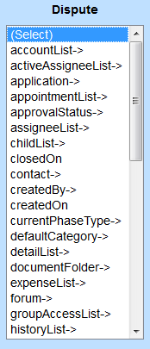
Rules – Object Navigator
Bridge attributes have an arrow (->) next to them
Bridge attributes can be used as either a traverse path linked to other tables or as an end of path attribute
Example of Attributes: closedOn, createdOn
Example of Bridges: detailList->, groupAccessList->
Example of Bridge Attributes: createdBy->, contact->

Slide 38
Templates

Slide 39
Templates
Templates define what information should be automatically filled-in for each type of record, and what sub-object or related records should be automatically created
Templates can be used with wizards, pre-population rules, and custom action rules
Note: Only one template can be used per wizard

Slide 40
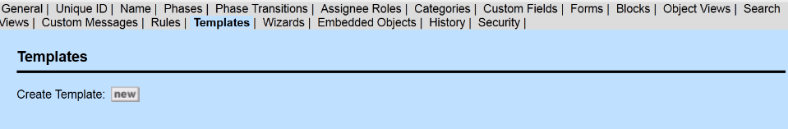
Templates
Before creating a Pre-population rule, we will need to create a template because the action for a Pre-population rule is the template
The Templates tab in the object definition is where to create a new template
Notes:
Templates are used to specify an action to take place when triggered. This includes creating new folders in a record or creating a task.

Slide 41
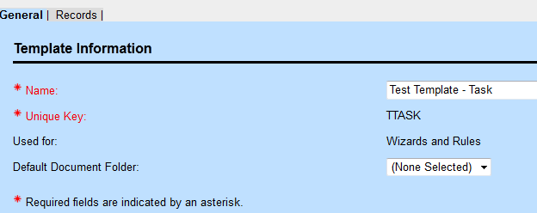
Templates
Create a name for the template that accurately describes the function of the template
Ex: Template for Subpoena Disputes
Decide whether this template will be used for rules, wizards, or both
Templates created in or uploaded to TeamConnect can be selected from the document folder
Notes:
Name and unique Key
Used for Wizards, Rules, or Both
Default Document Folder

Slide 42
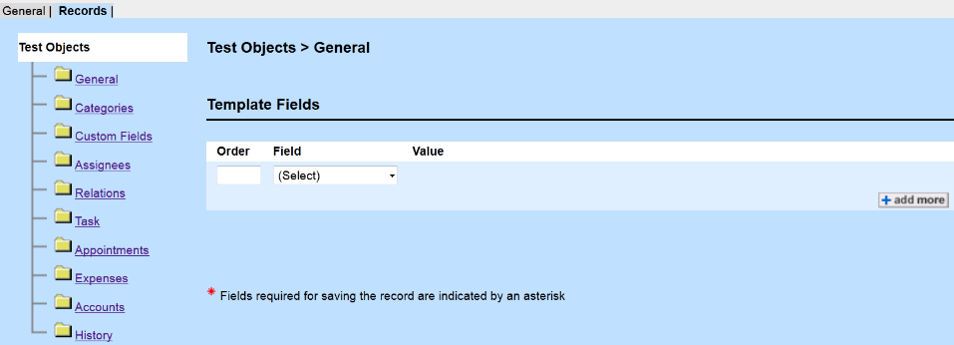
Templates
The Records tab in Templates shows the available fields and sub-objects that can be created or filled-in when triggered by a rule
Notes:
Created Tasks
Show example of how a template can be made to create a task for the main assignee when record is created
Click on Task folder
Create a friendly name: Task for New Records (or something like this)

Slide 43
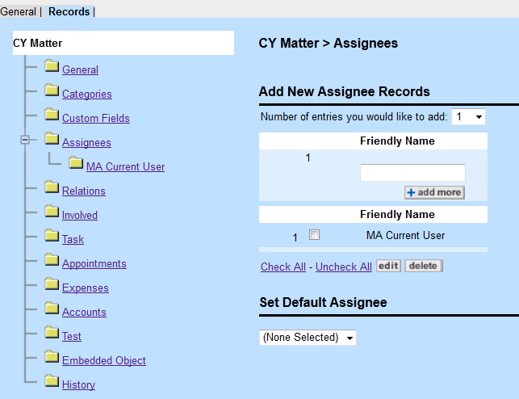
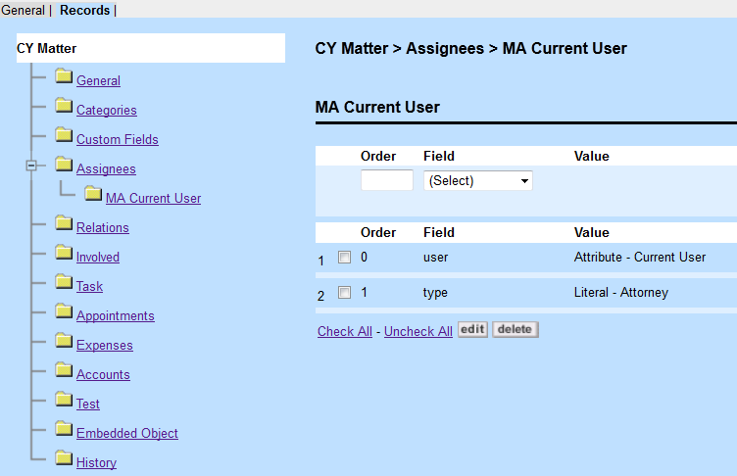
Templates – Examples
Example of how to make the Main Assignee the current user as the role attorney

Slide 44
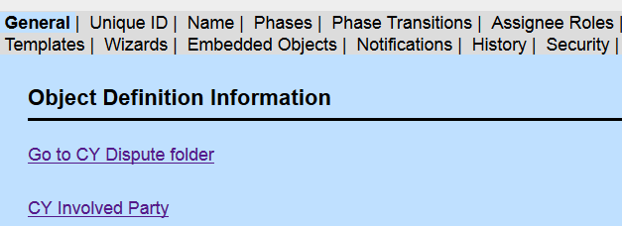
Templates – Examples: Document Folders
Default Document Folders
To create folder structures or add documents to a record automatically, template folders need to be created then called upon in a Template that is used for a wizard and/or rule
Go to the General tab of the object definition and click on the link to the object folders

Slide 45
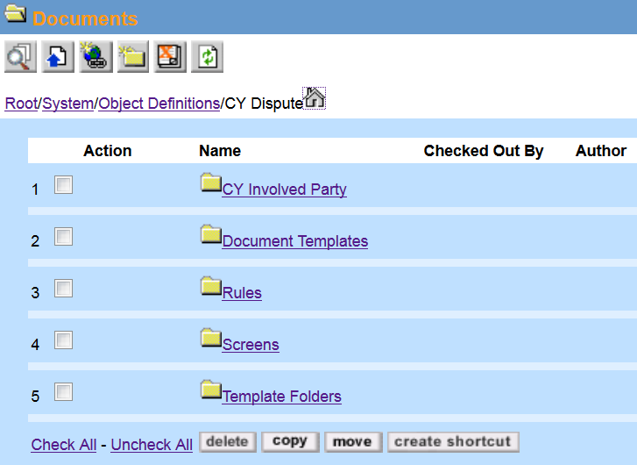
Templates – Examples: Document Folders
Then click on the Template Folders

Slide 46
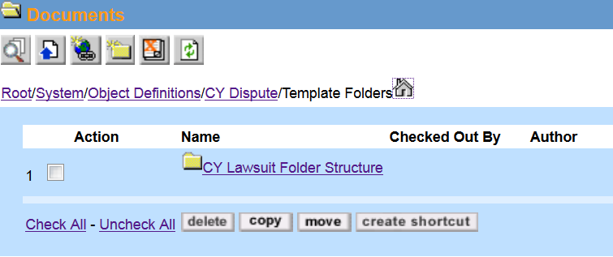
Templates – Examples: Document Folders
In the Template Folders, create the name of the folder structure to call upon later
Note: This is just a friendly name to select from in the Template section
Click on New Folder

Slide 47
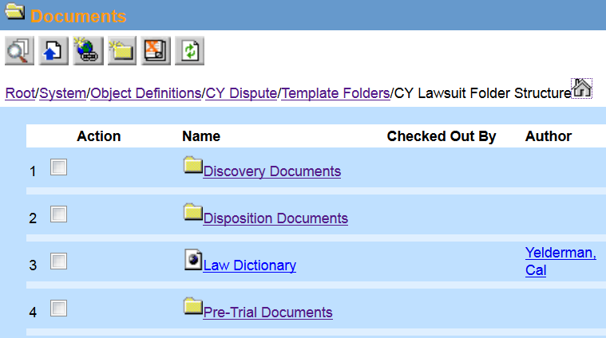
Templates – Examples: Document Folders
In the folder that is used as a friendly name, create the folder structure and add any files that are needed
Below is an example of three folders and a link to a Law Dictionary website

Slide 48
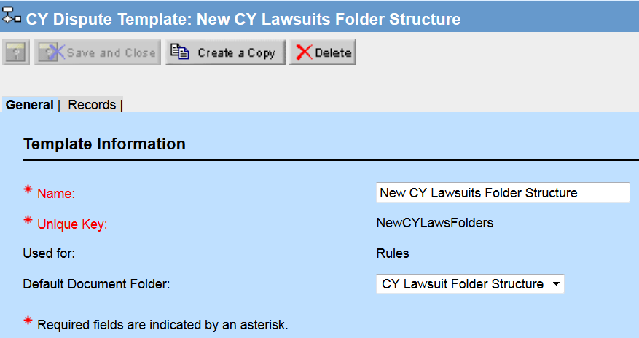
Templates – Examples: Document Folders
Finally, create a template from the template tab in the Object Definition
Then select the Default Document Folder with the friendly name used in this example

Slide 49
Pre-Population Rules

Slide 50
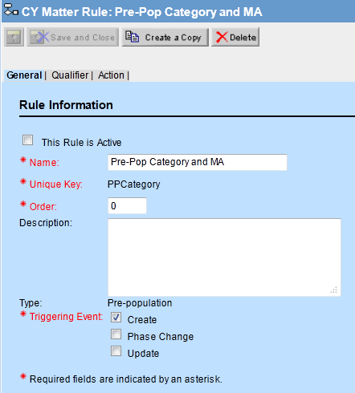
Pre-Population Rules
Pre-population rules have the triggering events create, phase change, and update
The qualifier must define when this happens, so for a creation rule that applies to all records, we can leave the qualifier tab blank
Notes:
The qualifier is the same as Security. Here the action is a template: could be startup folders, or a task like the one we created.

Slide 51
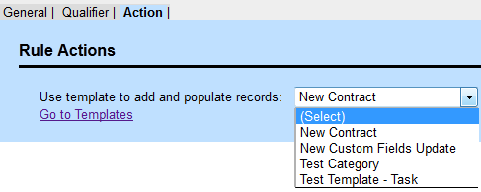
Pre-Population Rules
Creating the template was the first part, so without any qualifiers, we can just go to the Action tab and select the correct template
Notes:
The qualifier is the same as Security. Here the action is a template: could be startup folders, or a task like the one we created.

Slide 52
Validation Rules

Slide 53
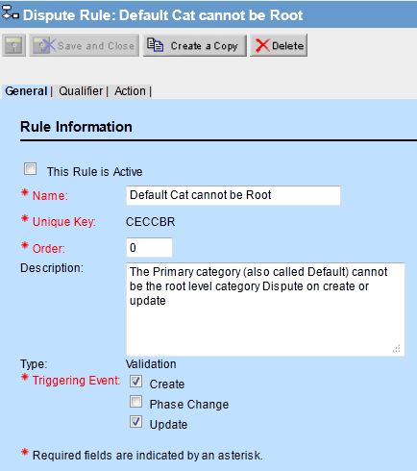
Rules – Validation
Validation rules help ensure records are accurately filled out before they can be created, updated, or changed to the next phase
Validation rules on phase changes ensure workflow procedures are being followed by the user
The following set of slides show an example of a validation rule that requires the user to change the default or primary category to something besides the root category
Note: The triggering event is both create and update
Notes:
Validation Rule in Dispute Object
This is the qualifier for the rule, validation is checked, if it is triggered, the action follows with the message telling the user what to do to achieve validation.

Slide 54
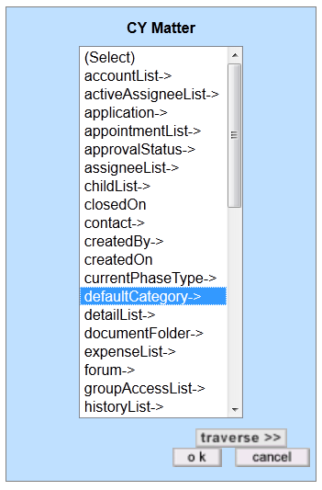
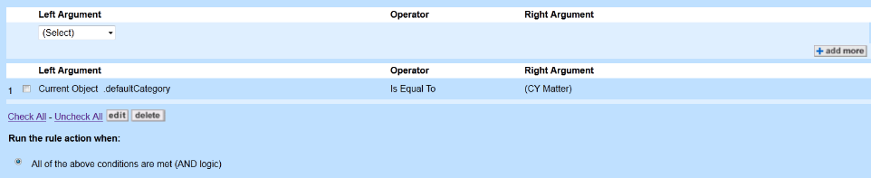
Rules – Validation
For this rule, there is only one qualifier needed: the default category cannot be the root
Note: It is important to remember the root category for any object is the same name as that object
The following example is for custom object CY Matter
The rule will execute when the default category is equal to the root category CY Matter
Notes:
Validation Rule in Dispute Object
This is the qualifier for the rule, validation is checked, if it is triggered, the action follows with the message telling the user what to do to achieve validation.

Slide 55
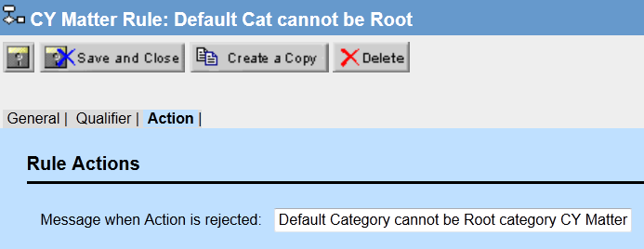
Rules – Validation
Similar to security rules, validation rule actions are custom error messages for the users
Make sure the end users understand the error and know how to take appropriate action
Note: this could mean they need to change the category like this example or that they do not have the authority to make the changes they are trying to do
Notes:
Validation Rule in Dispute Object
This is the qualifier for the rule, validation is checked, if it is triggered, the action follows with the message telling the user what to do to achieve validation.

Slide 56
Rules – Validation Example 2
Example: Prevents a new custom object record from being created if the Incident Date (a custom field) is in the future.

Slide 57

Rules – Validation Example 2
Qualifier: Is Incident Date in the future?
Example: Prevents a new Dispute record from being created if the Incident Date (a custom field) is in the future.

Slide 58
Rules – Validation Example 2
Action: Display message to user
Example: Prevents a new Dispute record from being created if the Incident Date (a custom field) is in the future.

Slide 59
Routes

Slide 60
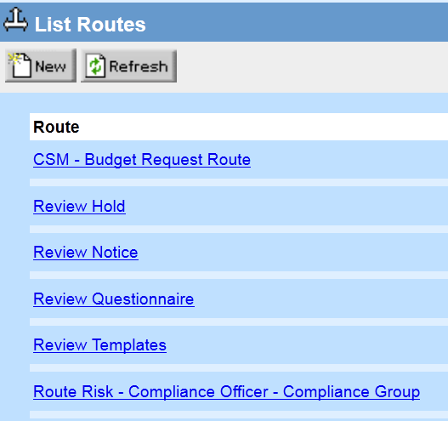
Routes
Approval Rules must have an actions, and that action is a route
Before we create an Approval Rule, we need to create a route
Note: Routes can also be accessed from the rule
In the Setup/Designer, go to Routes under the “Go to . . .” tab
Create a new Route by selecting New
Notes:
Creating a Route

Slide 61
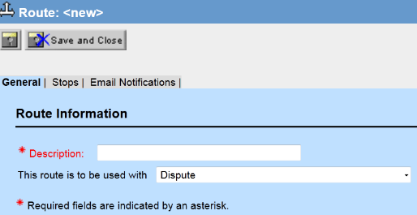
Routes – New
Create a description for the route
Note: Routes can be used for multiple rules and even multiple objects so be sure to name it accurately
Choose what object this route will be used for
Note: The route can be used for all objects, but the paths for the stops will depend on the object selected
Notes:
Make sure the route is used with the correct object. For the students it will be their custom object.
The description needs to be clear and concise
Route must be saved to get to the routes.

Slide 62
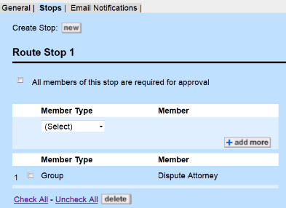
Routes
Create a new stop by selecting new at the top of the Stops tab
Note: Adding more groups or users to a stop does not add more stops, but instead adds more users that will need to approve or reject the request at the specific stop
Each stop can require all of the users to approve or require just a single user to approve the request at the stop
Notes:
Stops: Can create multiple stops.
All members at stop are required?
Member types: Group, User path, and User with Role

Slide 63
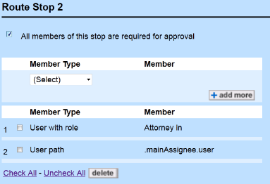
Routes
In addition to groups, users with roles or paths can be added to a stop
Users with a role indicate any user in TeamConnect that has a specified assignee role in a related object (Ex: Child-Parent)
Users with paths require traversing the object navigator to find someone like the main assignee of the dispute to be an approver at this stop
Note: The User with path and role are dynamic
Notes:
Can have multiple members at one stop.
User with a role like attorney
Or a user path like the main assignee

Slide 64
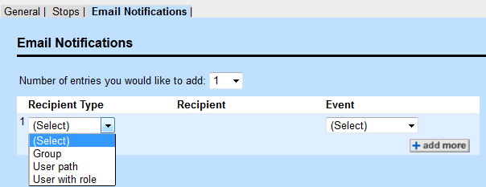
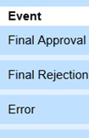
Routes
Groups and users can also be emailed upon the final approval, rejection, or in the event there is an error
Note: These recipients do not have to be a part of the approval process to receive an email, but they must be users
Notes:
Routes can utilize email notification.
Can send to groups, users with path, and users with roles
The emails can be sent on the event of an approval, a rejection, or an error.

Slide 65
Approval Rules

Slide 66
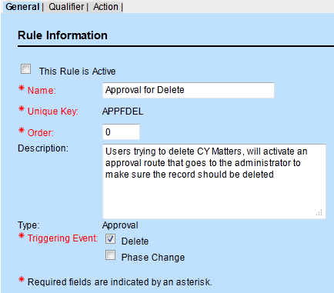
Approval Rules
This example approval rule will show how a record cannot be deleted until it is approved through a workflow route with the exception of system administrators
The qualifier will allow system administrators to delete records without going through the approval route
The trigger for approval rules can also be on phase changes
Notes:
The rule is triggered on a phase change, so there is not need for qualifiers here.

Slide 67
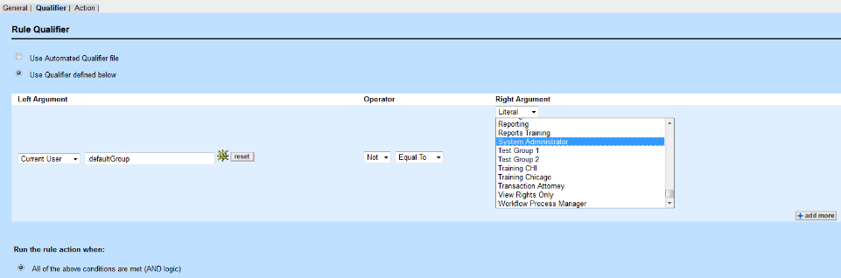
Approval Rules
If this delete trigger was for all users, the qualifier would be left blank
This example needs a qualifier that allows system administrators to delete without the rule firing
If using a custom sequence, the qualifier will often be left blank

Slide 68
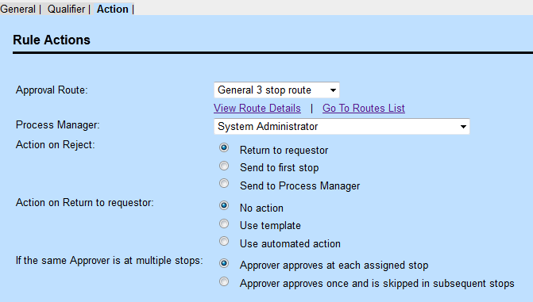
Approval Rules
For the action on an approval rule, select the appropriate route
Note: The role of the process manager is for a qualifying option on reject, but it can be any group selected here as the process managers
Process managers will be able to view all records in the workflow, including pending and completed
TeamConnect administrators should have visibility for workflows
Possible Actions on rejecting the request
Approvers at multiple stops
Can the records be edited?
Notes:
A route needs to be made first for approval rules. When the rule is triggered, the route begins. This is great for workflow and making sure the appropriate people validate records and actions in teamconnect.
If the process is rejected, the request is sent back to the first stop
If someone is a part of the approval route more than once, they can approve each time or just once
Stop level parameters are the conditions at each stop, route level parameter are the ones that follow this slide

Slide 69
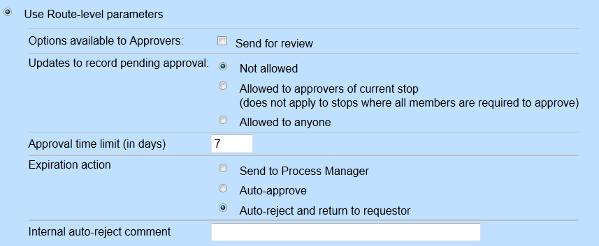
Approval Rules
There is an option to use route-level parameters or stop-level parameters
Stop-level parameters allow for configuration of how individual approval stops will handle the approval and includes additional functionality over route-level parameters
Notes:
These are options are the same for everyone at all stops

Slide 70
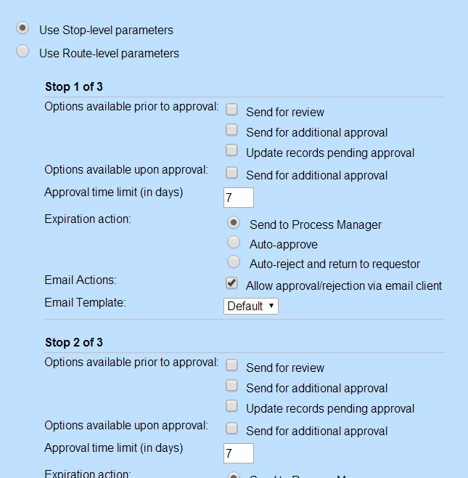
Approval Rules
Stop-level parameters can be configured to allow users to dynamically create new approval stops
Approval via email can be enabled for individual stops and a template can be used in conjunction with that approval
Notes:
These options are specific to the people at the specific stops

Slide 71
Validation Rules

Slide 72
Rules – Validation
Validation rules help ensure records are accurately filled out before they can be created, updated, or changed to the next phase
Validation rules on phase changes ensure workflow procedures are being followed by the user
Here is an example of a validation rule that requires the user to change the default or primary category to something besides the root category
Note: The triggering event is set to both create and update
Notes:
Validation Rule in Dispute Object
This is the qualifier for the rule, validation is checked, if it is triggered, the action follows with the message telling the user what to do to achieve validation.

Slide 73
Rules – Validation
Oone qualifier needed: the default category cannot be the root
Note: It is important to remember the root category for any object is the same name as that object
The following example is for custom object CY Matter
The rule will execute when the default category is equal to the root category CY Matter
Notes:
Validation Rule in Dispute Object
This is the qualifier for the rule, validation is checked, if it is triggered, the action follows with the message telling the user what to do to achieve validation.

Slide 74
Rules – Validation
Similar to security rules, validation rule actions are custom error messages for the users
Make sure the end users understand the error and know how to take appropriate action
Note: this could mean they need to change the category like this example or that they do not have the authority to make the changes they are trying to do
Notes:
Validation Rule in Dispute Object
This is the qualifier for the rule, validation is checked, if it is triggered, the action follows with the message telling the user what to do to achieve validation.

Slide 75
Custom Action Rules

Slide 76
Custom Action Rules
Custom rules must have custom actions that have previously been written in Java and then added to TeamConnect as a .class file
Custom rules can be triggered on create, update, delete, phase change, or user invoke
User invoke means that there is a link to run this rule at any time the user decides
Custom rules can have automated qualifiers or qualifiers defined by the administrator in the object definition

Slide 77
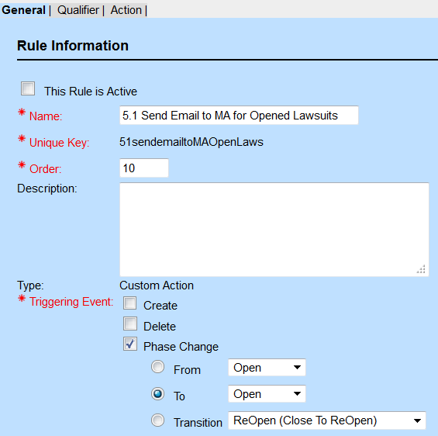
Custom Action Rules
Create a custom action rule
Ex: When Lawsuits are opened, send Notification Email Template X to the Main Assignee

Slide 78
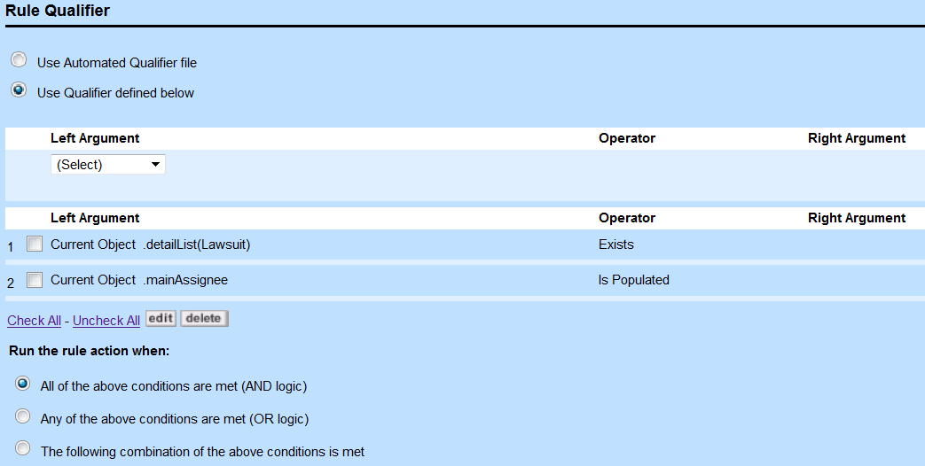
Custom Action Rules
Make sure the rule verifies that the custom field has a value and that there is a Main Assignee on the record

Slide 79
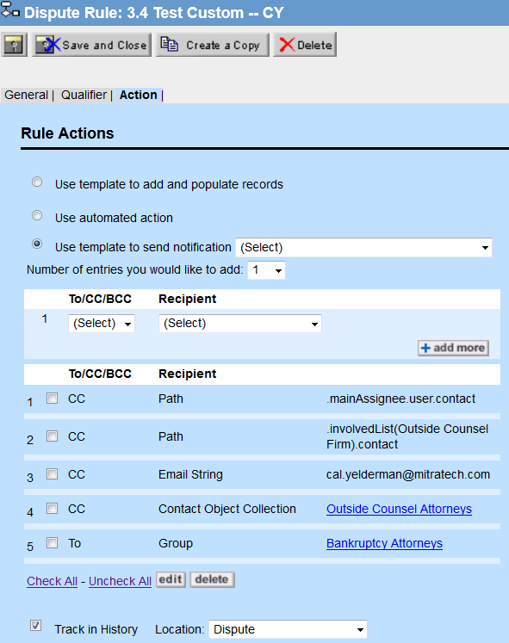
Custom Action Rules
Custom Action Rules can use a template to send a notification
Select the Template to be sent: Main Assignees for Opened Lawsuits
Select the recipient(s): Object path, group, address book, contact object search collection, or email string

Slide 80
Custom Action and Schedule Action Rules
Sending Emails with Custom and Scheduled Action Rules:
Make sure the path ends in a contact and contacts have an email address in the system
Emails sent can be tracked in history records

Slide 81
Scheduled Action Rules

Slide 82
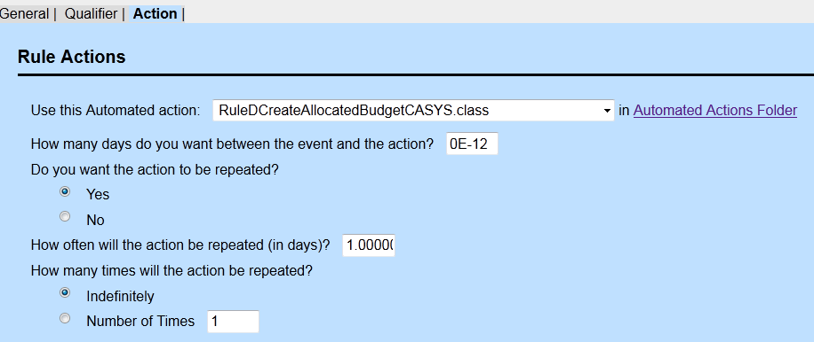
Schedule Action Rules
Scheduled Action rules are very similar to Custom Action rules with the addition of scheduling options for the the action
In the action tab, define the duration between the triggering event and the action as well as the number of times the action will be repeated and how often it will be repeated
Notes:
This rule can also be triggered by the user
Qualifiers are the same as others
Must be a custom action
Time and duration can be adjusted

Slide 83
Example – Schedule Action Rules
Example: A Scheduled Action Rule sends an email to the main assignee and the paralegal to fill in the appropriate fields and then change the phase on a new case
The email template is created first (TC Admin tab), explaining that certain fields need to be filled out and then the phase needs to be changed from intake to open
Use the qualifier to determine the current phase is intake before sending the email

Slide 84
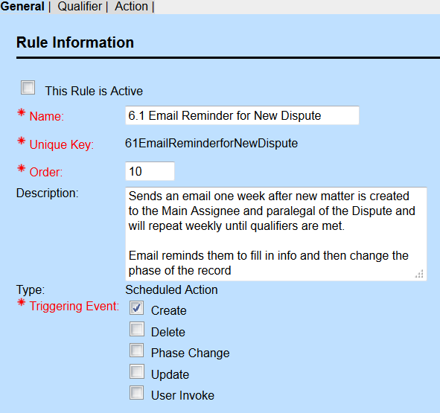
Example – Schedule Action Rules
Name the rule and describe it in detail
Make sure to select the Type: Scheduled Action and then the trigger

Slide 85
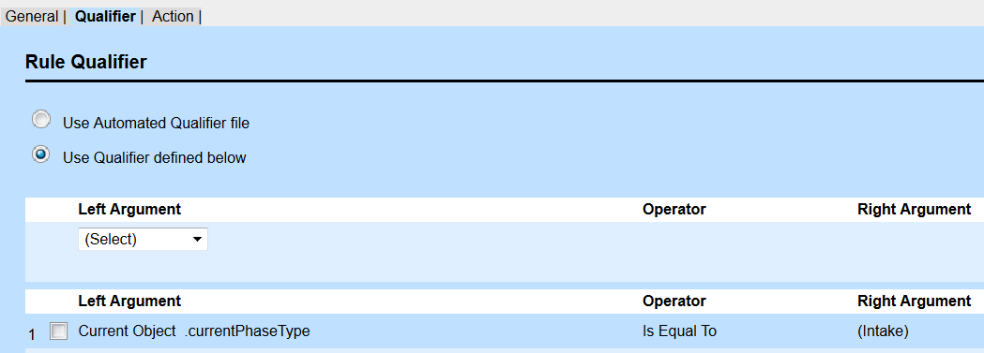
Example – Schedule Action Rules
The phase should be the initial phase or similar initial phase

Slide 86
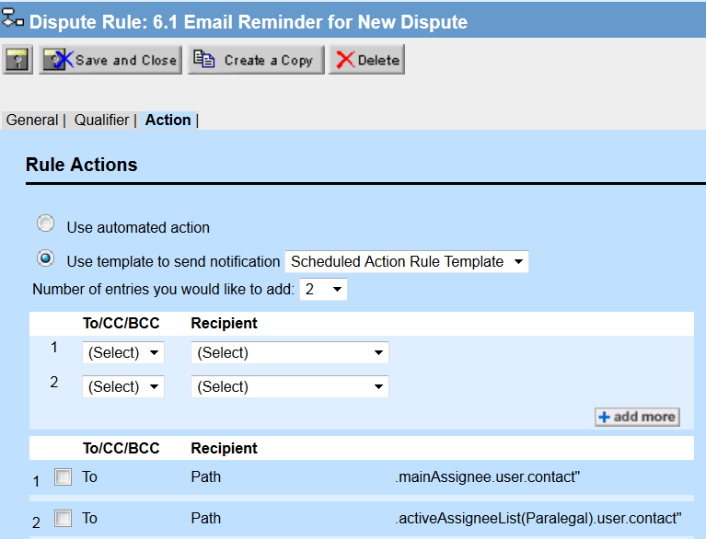
Example – Schedule Action Rules
Select the template email notification to be used
Then select the recipients of the email

Slide 87
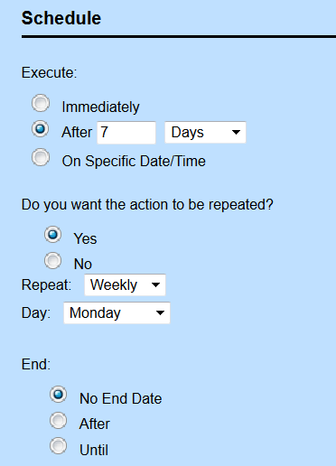

Example – Schedule Action Rules
At the bottom of the Action Tab, set the schedule for when the action should be executed (email should be sent)
Then decide if the action should be repeated
Include the repetition schedule and the duration of the repetition

Slide 88
Post Commit Rules

Slide 89

Post Commit Rule
Post Commit rules trigger on Create, Delete, Phase Change, and Update, after the data is successfully saved to the database
Notification Templates are available for Post Commit Rules
Developers need to keep in mind that actions in the post commit rule are executed outside of a transaction and there should not be any updates to the current record within a post commit rule.
Notes:
Operate is changed in qualifier may require some special attention when implementing a post-commit rule

Slide 90
Audit Rules

Slide 91
Audit Rules
Audit rules can track changes to fields in TeamConnect objects
They can be triggered on create, update, delete, or phase change
Audit rules have qualifiers like other rules, but the action tab is different

Slide 92

Audit Rules
This rule will track changes to the Main Assignee field in dispute records
Make sure to include all triggering events, so that any create, delete, or update is recorded

Slide 93

Audit Rules
The qualifier needs to show any time the Main Assignee field is changed, added, or deleted

Slide 94

Audit Rules
The Audit rule action allows you to build the audit record to be generated. The format is dependent on the specific order used with text, spaces, and object attributes entered
Best practice is to write an example record out first before trying to enter the action message definition piece by piece
Indicate where this history record will be located (this record, parent record, object definition)
The following sentence says “Main Assignee is changed from SPACE (Main Assignee Old Value) SPACE to SPACE (Main Assignee New Value).”

Slide 95
JAVA RULES

Slide 96

Custom Action Rules: An Example
The following is a custom rule: Set Attorney as Main Assignee
Notes:
Qualifier is the same: Action is an automated action, which is why it is a custom rule

Slide 97

Custom Action Rules
The qualifier is something we could do in a GUI validation rule. Instead of just returning an error message, the custom action will automatically change the main assignee to the user with the role attorney

Slide 98

Custom Action Rules
The below .class file is the automated action that tells the system what to do when this rule triggers and is executed; in this case to set the attorney assigned as the main assignee.

Slide 99
API – Development Environment
Important Resources
Eclipse IDE
API JavaDoc
Team Connect help – Developer Help: success.mitratech.com
Development Environment
JRE version
Classpath API Jar Import
Set JavaDoc per TC Jar

Slide 100
Type of classes
Model Classes
Project, Contact, Invoice, etc.
Resource Services
Object-Specific Services
ProjectService, InvoiceService, etc.
Provides basic CRUD and Search operations
Transactional Services
Cross-object/Object Independent Services
UtilityService, SecurityService, CategoryService, InternationalizationService

Slide 101
API Package Classes
com.mitratech.teamconnect.enterprise.api Includes any general classes, mainly Platform.
com.mitratech.teamconnect.enterprise.api.callable Includes the four different types of callable methods that you use with UtilityService.runAsSystemUser().
com.mitratech.teamconnect.enterprise.api.custom Includes the classes you extend when you are creating custom screens, automated qualifiers, and automated actions.
com.mitratech.teamconnect.enterprise.api.model Includes the classes for all API objects that are not part of the other model packages.
com.mitratech.teamconnect.enterprise.api.model.custom Includes the API model classes for all design entities.

Slide 102
API Package Classes
com.mitratech.teamconnect.enterprise.api.model.enums API model classes for all enumerations
com.mitratech.teamconnect.enterprise.api.model.exceptions API model classes for all exceptions.
com.mitratech.teamconnect.enterprise.api.model.parameters API model classes for all parameters.
com.mitratech.teamconnect.enterprise.api.model.search API model classes for searching
com.mitratech.teamconnect.enterprise.api.service includes all the service classes.

Slide 103
API Package Classes
com.mitratech.teamconnect.enterprise.api.custom
CustomAction<M extends Entity>
CustomBlock<M extends EnterpriseEntity>
CustomCondition<M extends Entity>
CustomTool
ScheduledCustomAction
WizardCustomBlock <M extends EnterpriseEntity>

Slide 104
Logging
Logging uses log4j to allow developers to write messages and error to the server logs.
Logging methods available automatically
logDebug(…)
logInfo(…)
logWarn(…)
logError(…)
Appropriate logger already assigned
Rule logger for rules, Blocks logger for CJBs
Rule execution logging
Start and end of rule execution logged at INFO level

Slide 105
Team Connect Development
Let’s build something!
Example 1:
Log message “Hello World! From: <your name>”
Key Points:
- Add a new Custom Action rule (trigger on create)
- Custom Item to extend: CustomAction
- EnterpriseEntity to use: Project
- Method to override: action()
- Method to use: (CustomAction.)logDebug()

Slide 106
Team Connect Development
import com.mitratech.teamconnect.enterprise.api.custom.CustomAction;
import com.mitratech.teamconnect.enterprise.api.model.Project;
public class MyFirstCustomAction extends CustomAction<Project> {
@Override
public void action(Project arg0) {
this.logDebug("This is a Hello World test message. Hello, world. From Chris");
}
}

Slide 107
Team Connect Development
Example 1 version2:
Log message “Hello World! From: <your name>”
Key Points:
- Same rule as before, update the Java code
- Service to use: UtilityService
- Method to use:
(CustomAction.)logDebug()
UtilityService.???? (Group Discussion)

Slide 108
Team Connect Development
import com.mitratech.teamconnect.enterprise.api.custom.CustomAction;
import com.mitratech.teamconnect.enterprise.api.model.Project;
public class MyFirstCustomAction extends CustomAction<Project> {
@Override
public void action(Project arg0) {
this.logDebug("This is a Hello World test message. Hello, world. From "+platform.getUtilityService().getCurrentUser().getUsername());
}
}

Slide 109
Custom Rules – API Basics – Entity Layer
Friendly Name | API Interface Name | Unique Code/ Entity Code | Database Table Name
Account | Account | ACCT | T_ACCOUNT
Appointment | Appointment | APPT | T_APPOINTMENT
Contact | Contact | CONT | T_CONTACT
Document | Document | DOCU | T_DOCUMENT
Expense | Expense | EXPE | T_EXPENSE
History | History | HIST | T_HISTORY
Invoice | Invoice | INVC | T_INVOICE
Involved | Involved | INVL | T_INVOLVED
Milestone | Milestone | MILE | T_MILESTONE
Project | Project | Unique Code: Assigned by the solution developer through the UI when the creation of the custom object Entity Code: PROJ | T_PROJECT
Task | Task | TASK | T_TASK

Slide 110
Custom Rule Classes
Qualifiers extend CustomCondition<? extends EnterpriseEntity>
Actions extend CustomAction<? extends EnterpriseEntity>
No need for constructor
Public boolean condition(final T record) for conditions
Public void action(final T record) for actions
“platform” available to get references to services
Logging methods available

Slide 111
Custom Rules – API Basics – Unique Codes
Unique Codes for custom and system objects:
System: History → HIST (pre-defined)
Custom: Litigation → LITI (user defined)
Custom Dispute object’s category:
INP2_CAT1
DISP_CAT1_SUB1

Slide 112
Custom Rules – API Basics – Unique Codes
Unique Codes for Categories:
System: (Root) History → HIST (pre-defined)
(Sub-category) History → Amount Change → HIST_AMCH
Custom: (Root) Litigation → LITI
(Sub-category) Litigation → Appeals → LITI_APPL

Slide 113
Custom Rules – API Basics – Unique Codes
Unique Code for Lookup Tables:
System: Address Type → ADDR (pre-defined)
Phone Type → PHON (pre-defined)
Custom: Action → ACTI
Bankruptcy Type → BANK

Slide 114
Custom Rules – API Basics – Tree Positions & Keys
The API makes reference to Keys and Tree Positions for extracting and setting objects and values
For custom fields: Key = field name
For all other references to keys (excluding database primary keys):
Key = concatenation of unique codes separated by single underscores
DISP_Cat1_Sub1_CustomFieldName

Slide 115
Custom Rules – API Basics – Important Methods
Limitations:
Limited by preferences in Admin Preferences area in TeamConnect
In Admin Preferences:
Example: Max # of result set = 200 records
Example: Time before timeout = 10 seconds

Slide 116
Custom Rules – API Basics – Important Methods
Overcoming those Limitations:
The API provides methods to bypass the Admin Preferences:
SearchParameters – define the properties specific to your search
doNotUseLimits() – ignore the maximum count and timeout set in Preferences

Slide 117
Custom Java Rules
Java rules are defined in both the UI and Java class files
Have a trigger, a qualifier, and an action (just like GUI Rules)
Trigger: Operation such as deleting or updating a record, voiding a task, or changing a phase.
Qualifier: Condition that determines whether the action will be executed.
Action: What the rule does when the conditions are met. Can be defined through GUI or a Java file.

Slide 118
Custom Rules – Qualifiers
Determines whether the associated action will be executed
Can be defined either in a Java file uploaded to TeamConnect – called Automated Qualifier, or directly through the GUI
Returns: true → execute action false → do not execute action

Slide 119
Custom Rules – Automated Qualifiers
When to create Automated Qualifiers (upload a Java class)?
Need to be compare values from two or more different objects
Perform calculations like adding 30 days to a date value
Check the value of more than one field in a sub-object/related object

Slide 120
Custom Rules – Automated Qualifiers
Automated Qualifier Java classes
extend CustomCondition<Project>
implement condition() method
Upload under
Root\System\Object Definitions\<Object Name>\Rules\Automated Qualifiers

Slide 121
Custom Rules – Class Naming
Following the standard naming procedure makes maintenance easier.
ObjectUniqueCode_RuleNumber_Desription_TriggerType
e.g. DISP_2_4_SetMatterNumberString_C
ObjectUniqueCode is the unique code of the system or custom object that the rule is applied to;
RuleNumber is the rule number(s) specified in the business rule specification document.
Description is the description of the rule(s), which should be close to the rule name described in the rule specification as much as possible.

Slide 122
Custom Rules – Class Naming
Use the underscore to replace the period from the rule name
e.g. If the rule number is 2.1, write “2_1”.
If a class is used for two rules, use the word “and” to separate the numbers.
e.g. If the class is used for Rules 2.1 and 3.1, write “2_1_and_3_1”
If a class is used for more than two rules and there are in a continuous range, use the word “to”
e.g. If the class is used for Rules 1.5 to 1.9, write “1_5_to_1_9”

Slide 123
Custom Rules – Class Naming
TriggerType is the upper case character(s) of type of the trigger of the rule.
C – Create
U – Update
D – Delete
CU – Create and Update
UI – User Invoke
SA – Scheduled Action

Slide 124


Custom Rules – Class Naming
We use the object unique code as folder name for files in system or custom objects. Each folder may have actions, qualifiers and screens sub-folders for custom actions, custom qualifiers and CJBs.
Saving source files – locally or in Version Control
Follow the Team Connect object structure
Main folder with Object code, subfolders for Actions, Qualifiers, Screens.
Code not object-specific should go into a separate System folder, in an appropriate subfolder.

Slide 125
Custom Rules – Automated Qualifiers – Example
Example 1:
Limit the name of a record to 20 characters maximum.
Notes:
Sample is in slides but to open in a different file, see TASK_Q_VerifyActivityandTotal_C.java

Slide 126
Team Connect Development
import com.mitratech.teamconnect.enterprise.api.custom.CustomCondition;
import com.mitratech.teamconnect.enterprise.api.model.Project;
public class ZZZZ_3_1_RecordNameCanNotBeMoreThan20Characters_Qualifier_CU extends CustomCondition<Project>{
@Override
public boolean condition(Project currentRecord) {
String name = currentRecord.getName();
logDebug("Name of current record is: " + name);
return name.length() > 20L; //L is not needed
}
}

Slide 127
Custom Rules – Parameters
Parameters – Editable fields which appear and are hard-coded to a value on the Rule creation screen in the related object’s setup definition. An administrator/developer enters field values which can be used to populate values in the rule action.
To access these parameters, the developer will need to implement the method declareParameters()
@Override
public void declareParameters() {
parameters.addTextParameter("text", "Text", "default value");
parameters.addPasswordParameter("password", "Password", "defaultpassword");
parameters.addBooleanParameter("actionBoolean", "action boolean",false);
}

Slide 128
Custom Rules – Parameters
parameters.addTextParameter("text", "Text", "default value");
1st parameter “text” is the parameter name that is referenced
2nd parameter “Text” is the display value
3rd parameter “default value” is the default value

Slide 129
Custom Rules – Automated Qualifiers – Example
Example 2: (parameterized version)
Check name of a record can not be have more than a number of characters specified via a parameter in the Setup screen for the rule.
Notes:
Sample is in slides but to open in a different file, see TASK_Q_VerifyActivityandTotal_C.java

Slide 130
Team Connect Development
import com.mitratech.teamconnect.enterprise.api.custom.CustomCondition;
import com.mitratech.teamconnect.enterprise.api.model.Project;
public class ZZZZ_3_1_RecordNameCanNotBeMoreThan20Characters_Qualifer_C extends CustomCondition<Project>{
@Override
public boolean condition(Project currentRecord) {
long lengthLimit = parameters.getNumberParameterValue("lengthLimit");
String name = currentRecord.getName();
logDebug("Name of current record is: " + name);
return name.length() > lengthLimit;
}
…Con’t

Slide 131
Team Connect Development
Con’t…
@Override
public void declareParameters() {
parameters.addNumberParameter("lengthLimit", "Enter the maximum number of characters that record can have:", 20L);
super.declareParameters();
}
}

Slide 132
Custom Rules – Automated Qualifiers – Example
Example 3:
Difference between request date and response due date can not be less than 7 days.

Slide 133
Team Connect Development
import java.util.Calendar;
import java.util.Date;
import com.mitratech.teamconnect.enterprise.api.custom.CustomCondition;
import com.mitratech.teamconnect.enterprise.api.model.Project;
public class ZZZZ_3_2_ValidateDiffBtwnRqustDateAndRspnsDueDate_Qualifer_CU extends CustomCondition<Project> {
private static final String CF_ZZZZ_RequestDate = "RequestDate";
private static final String CF_ZZZZ_ResponseDueDate = "ResponseDueDate";
@Override
public boolean condition(Project currentRecord) {
Date requestDate = currentRecord.getDateFieldValue(CF_ZZZZ_RequestDate);
Date responseDueDate = currentRecord.getDateFieldValue(CF_ZZZZ_ResponseDueDate);
…Con’t

Slide 134
Team Connect Development
Con’t…
if(requestDate != null && responseDueDate != null) {
Calendar requestCal = Calendar.getInstance();
requestCal.setTime(requestDate);
Calendar responseCal = Calendar.getInstance();
responseCal.setTime(responseDueDate);
//add 7 days to requestCal
requestCal.add(Calendar.DAY_OF_YEAR, 7);
return requestCal.compareTo(responseCal) > 0;
}
return false;
}
}

Slide 135
Custom Rules – Automated Qualifiers – Example
How to get today’s date:
Date currentDate = platform.getUtilityService().getBeginningOfToday();
CalendarDate is a date without any time component. A date represented by this class will always represent a date such that the time value in GMT will have 0 hours, 0 minutes, 0 seconds, and 0 milliseconds.
The class Date represents a specific instant in time, with millisecond precision.

Slide 136
Custom Rules – Automated Qualifiers – Example
Example 3b: (parameterized version)
Difference between request date and response due date can not be less than a number of days specified by the user on the Setup screen for the Rule.

Slide 137
Team Connect Development
import java.util.Calendar;
import java.util.Date;
import com.mitratech.teamconnect.enterprise.api.custom.CustomCondition;
import com.mitratech.teamconnect.enterprise.api.model.Project;
public class ZZZZ_3_2_ValidateDiffBtwnRqustDateAndRspnsDueDate_Qualifer_C extends CustomCondition<Project> {
private static final String CF_ZZZZ_RequestDate = "RequestDate";
private static final String CF_ZZZZ_ResponseDueDate = "ResponseDueDate";
@Override
public boolean condition(Project currentRecord) {
Long lengthLimit = parameters.getNumberParameterValue("lengthLimit");
Date requestDate = currentRecord.getDateFieldValue(CF_ZZZZ_RequestDate);
Date responseDueDate = currentRecord.getDateFieldValue(CF_ZZZZ_ResponseDueDate);
…Con’t

Slide 138
Team Connect Development
Con’t…
if(requestDate != null && responseDueDate != null) {
Calendar requestCal = Calendar.getInstance();
requestCal.setTime(requestDate);
Calendar responseCal = Calendar.getInstance();
responseCal.setTime(responseDueDate);
//add 7 days to requestCal
requestCal.add(Calendar.DAY_OF_YEAR, lengthLimit.intValue());
return requestCal.compareTo(responseCal) < 0; }
return false;
}
…Con’t

Slide 139
Team Connect Development
Con’t…
@Override
public void declareParameters() {
parameters.addNumberParameter("lengthLimit", "Enter the maximum number of days to allow:", 7L);
super.declareParameters();
}
}

Slide 140
Custom Rules – Automated Condition– Example
Example 4:
Checking whether the Project name has changed
Rule Type: Validation
Rule Trigger: Update
Actions: When a user edits a record, check if the name has changed.

Slide 141
Team Connect Development
import org.apache.commons.lang.StringUtils;
import com.mitratech.teamconnect.enterprise.api.custom.CustomCondition;
import com.mitratech.teamconnect.enterprise.api.model.Project;
public class ZZZZ_3_6_CheckIfNameChanged extends CustomCondition<Project>
{
@Override
public boolean condition(final Project record) {
Project initialProject = platform.getProjectService().readLastSaved(record);
if (StringUtils.isBlank(initialProject.getName())) {
return !StringUtils.isBlank(record.getName());
} else {
return !initialProject.getName().equals(record.getName());
}
}
}
--Instead of StringUtils(), could also use String.IsEmpty()

Slide 142
Team Connect Development
import com.mitratech.teamconnect.enterprise.api.custom.CustomCondition;
import com.mitratech.teamconnect.enterprise.api.model.Project;
public class ZZZZ_3_3_CheckIfNameChanged extends CustomCondition<Project>
{
@Override
public boolean condition(final Project record) {
Project initialProject = platform.getProjectService().readLastSaved(record);
if (initialProject.getName().isEmpty()) {
return !record.getName().isEmpty();
} else {
return !initialProject.getName().equals(record.getName());
}
}
}
--Instead of StringUtils(), could also use String.IsEmpty()in Java 8 and above

Slide 143

Custom Rules – Rules
Actions are what a rule does if the conditions specified in its qualifier are met.
Are executed when qualifiers return true.
Can be a simple error message (Validation that uses either GUI or Automated Qualifiers):

Slide 144
Custom Rules – Actions
Or a Java class – called Automated Actions:
Creating/deleting/updating other records
Sending emails
Modifying other fields in the record

Slide 145
Custom Rules – Automated Actions
Automated Actions Java classes
extend CustomAction
implement action() method
Upload under
Root\System\Object Definitions\<Object Name>\Rules\Automated Actions
Unlike automated qualifiers that must return a boolean value, actions do NOT return values – return type of Void
Only Custom and Scheduled Action rules can have automated actions
Automated actions can have parameters

Slide 146
Custom Rules – Parameters
Retrieving parameters in action or condition method
@Override
public void action(final Project dispute) {
dispute.setName(parameters.getTextParameterValue("text"));
String myPassword = parameters.getTextParameterValue(“password”);
}

Slide 147
Custom Rules – Automated Action – Example
Example 1:
Remove Sensitive Text from a Matter Name
Object: Project
Rule Type: Custom Action
Rule Trigger: Create
Action: When a project is created, remove sensitive words from the name.
Key Points:
-Method to use:
- currentRecord.setTextFieldValue
-Create custom field:
- Public Name

Slide 148
Team Connect Development
import com.mitratech.teamconnect.enterprise.api.custom.CustomAction;
import com.mitratech.teamconnect.enterprise.api.model.Project;
public class ZZZZ_5_1_MaskName_Action_CU extends CustomAction<Project> {
@Override
public void action(final Project currentRecord) {
String name = currentRecord.getName();
String maskedName = name.replace("FileNo", "");
//alternate case-insensitive name.replaceAll(“(?i)FileNo", "");
currentRecord.setTextFieldValue("PublicName", maskedName);
}
}

Slide 149
Custom Rules – Automated Action – Example
Example 1a:
Remove Sensitive Text from a Matter Name, even if the user can’t write to the target field
Notes:
Echo’s #4 Demo_CustomFieldPopulate.java

Slide 150
Custom Rules – Automated Action – Example
Running a rule as the system user
Method to change to the system user for rule execution in scenarios requiring a lot of TeamConnect permissions (rights to create/update records)
platform.getUtilityService().runAsSystemUser(new Callable() {
public void call() {
// do something
}
});

Slide 151
Team Connect Development
import com.mitratech.teamconnect.enterprise.api.callable.Callable;
import com.mitratech.teamconnect.enterprise.api.custom.CustomAction;
import com.mitratech.teamconnect.enterprise.api.model.Project;
public class ZZZZ_5_4_MaskName_Action_C extends CustomAction<Project> {
@Override
public void action(final Project currentRecord) {
logDebug("Current User 1:" + platform.getUtilityService().getCurrentUser());
platform.getUtilityService().runAsSystemUser(new Callable() {
@Override
public void call() {
String name = currentRecord.getName();
String maskedName = name.replace("FileNo", "");
currentRecord.setTextFieldValue("PublicName", maskedName);
Con’t…

Slide 152
Team Connect Development
…Con’t
logDebug("Current User 2:" + platform.getUtilityService().getCurrentUser());
} //this ends the public void call()
}); //this ends the run as system user
logDebug("Current User 3:" + platform.getUtilityService().getCurrentUser());
}
}
New code: lambda:
// Run as system user using Lambda Expression. This will not create the extra inner class file.
platform.getUtilityService().runAsSystemUser((Callable)() -> {
// Business Logic
});

Slide 153
Custom Rules – Automated Action – Example
Example 2:
Count the number of times the record has been saved.
Object: Project
Rule Type: Custom Action
Rule Trigger: Create and Update
Action: When a project is saved, increase a counter.
Key Points:
-Method to use:
- currentRecord.setNumberFieldValue
-Create custom field:
- numberOfSaves
Notes:
4/07/10 Echo’s #4 Demo_CustomFieldPopulate.java

Slide 154
Team Connect Development
import java.math.BigDecimal;
import com.mitratech.teamconnect.enterprise.api.custom.CustomAction;
import com.mitratech.teamconnect.enterprise.api.model.Project;
public class ZZZZ_5_2_CountSaves_CU extends CustomAction<Project>
{
private final String NUMBER_OF_SAVES = "numberOfSaves";
@Override
public void action(final Project record) {
BigDecimal numberOfSaves = record.getNumberFieldValue(NUMBER_OF_SAVES);
if (numberOfSaves == null) {
numberOfSaves = BigDecimal.ZERO;
}
record.setNumberFieldValue(NUMBER_OF_SAVES, numberOfSaves.add(new BigDecimal("1")));
}
}

Slide 155
Team Connect Development
Big Decimals in Team Connect
TeamConnect uses HALF_EVEN rounding mode:
netTotal = netTotal.setScale(2, RoundingMode.HALF_EVEN);
Setting initial values with defaults:
BigDecimal number1 = BigDecimal.ZERO;
BigDecimal number1 = BigDecimal.ONE;
BigDecimal number1 = BigDecimal.TEN;
Compare two BigDecimal numbers:
x.compareTo(y) <op> 0
Where <op> is one of these six comparison operators: [ <, ==, >, >=, !=, <= ]. x.compareTo(y) returns:
0 if x and y are equal
1 if x is greater than y
-1 if x is smaller than y

Slide 156
Custom Rules – Automated Action – Example
Example 3:
Throw an exception if the record is closed and someone tries to edit it
Object: Project
Rule Type: Custom Action
Rule Trigger: Update
Action: When a closed project is changed, throw an error
Key Points:
-Method to use:
- throw new APICustomException
Notes:
4/07/10 Echo’s #4 Demo_CustomFieldPopulate.java

Slide 157
Team Connect Development
import com.mitratech.teamconnect.enterprise.api.custom.CustomAction;
import com.mitratech.teamconnect.enterprise.api.model.Project;
import com.mitratech.teamconnect.enterprise.api.model.exceptions.APICustomException;
public class ZZZZ_5_3_Exception_Action_U extends CustomAction<Project>
{
private static final String ZZZZ_CLOSED_PHASE_TREE_POSITION = "CLOS";
private static final String ZZZZ_NOT_ALLOWED_MESSAGE = "custom.ZZZZ.rule.internationalizedExcpetion.notAllowedToChangeAClosedMatter";
@Override
public void action(final Project record) {
Project initialRecord = platform.getProjectService().readLastSaved(record);
if (initialRecord.getCurrentPhase().equals(ZZZZ_CLOSED_PHASE_TREE_POSITION))
{
throw new APICustomException("You're not allowed to change a closed matter“, ZZZZ_NOT_ALLOWED_MESSAGE, null);
}
}
}

Slide 158
Custom Rules – User-Invoked
Custom rules can also be defined as user-invoked.
Rather than being triggered passively by an action such as the creation or deletion of a record, the user intentionally invokes it by selecting it from a drop-down list (from a record’s Actions button).

Slide 159

Custom Rules – User-Invoked
Example 4:
Allow users to trigger an email to be sent at the discretion of the user, containing certain information from records in the database populated in the body of the email.
User-invoked actions drop-down list

Slide 160
Custom Rules – User-Invoked
Example 4:
User Invoked record status email send
Object: Custom Object
Rule Type: Custom Action
Rule Trigger: User Invoke
Actions: email is sent.

Slide 161
Team Connect Development
import com.mitratech.teamconnect.enterprise.api.custom.CustomAction;
import com.mitratech.teamconnect.enterprise.api.model.Contact;
import com.mitratech.teamconnect.enterprise.api.model.Email;
import com.mitratech.teamconnect.enterprise.api.model.EmailMessage;
import com.mitratech.teamconnect.enterprise.api.model.Project;
import com.mitratech.teamconnect.enterprise.api.model.ProjectAssignee;
public class CAM1_5_6_SendEmailToMainAssignee extends CustomAction<Project> {
@Override
public void action(Project currentRecord) {
//V2 HTML
//String subject = "Reminder Email: " + currentRecord.getName();
//String body = "<b>This record is pending your response: " + currentRecord.getName()+"</b><br>"+platform.getProjectService().getRecordUrl(currentRecord);
//end v2 html
ProjectAssignee mainAssignee = currentRecord.getMainAssignee();
if(mainAssignee == null) {
logDebug("Main assignee is null, therefore email is not being sent.");
return;
}
Con’t…

Slide 162
Team Connect Development
…Con’t
Contact mainAssigneContact = mainAssignee.getUser().getContact();
Email email = mainAssigneContact.getPrimaryEmail();
if(email== null) {
logDebug("Email address is not present on mail assignee.");
return;
}
//V4: use a Notification template
//EmailMessage message = new EmailMessage("ObjectNotification", currentRecord).fromSystem().to(email.getAddress());
//V3 method chaining
//EmailMessage message = new EmailMessage(subject, body).asHTML().fromSystem().to(email.getAddress());
EmailMessage message = new EmailMessage("This is a test email", "this is a test email notice");
//EmailMessage message = new EmailMessage(subject, body); //V2 HTML
message.fromSystem();
message.to(email.getAddress());
//message.asHTML();//V2 HTML
platform.getUtilityService().sendEmail(message);
}
}

Slide 163
Custom Rules – Automated Action – Example
Example 5:
Populating a Contact’s phone number list with the Contact Company’s default phone number.
Object: Contact
Rule Type: Custom Action
Rule Trigger: Create
Actions: Get a contact’s company.
Add the company’s default phone number - phone type to contact’s phone list.
Set the phone as contact’s default phone number.
Notes:
4/07/10 Echo’s #5 CONT_populatePhone.java

Slide 164
Team Connect Development
import com.mitratech.teamconnect.enterprise.api.custom.CustomAction;
import com.mitratech.teamconnect.enterprise.api.model.Company;
import com.mitratech.teamconnect.enterprise.api.model.Contact;
import com.mitratech.teamconnect.enterprise.api.model.Email;
import com.mitratech.teamconnect.enterprise.api.model.Person;
import com.mitratech.teamconnect.enterprise.api.model.PhoneNumber;
public class CONT_1_1_PopulatePhoneForPersonFromCompanyPhone_Action_C extends CustomAction<Contact> {
@Override
public void action(Contact contact) {
if(contact instanceof Person) {
Person person = (Person) contact;
Company company = person.getCompany();
if(company == null) {
return;
}
Con’t…

Slide 165
Team Connect Development
…Con’t
PhoneNumber companyPhoneNumber = company.getPrimaryPhoneNumber();
if(companyPhoneNumber == null) {
return;
}
person.addPhoneNumber(companyPhoneNumber.getPhoneNumberType(), companyPhoneNumber.getNumber());
}
}
}

Slide 166
Custom Rules – Custom Action – Example
Example 6
Searches for contact where the record name contains “s”.
Object: Contact
Rule Type: Custom Action
Rule Trigger: Scheduled Action
Actions: Writes the output of the search to the log.

Slide 167
Team Connect Development
import java.util.List;
import com.mitratech.teamconnect.enterprise.api.custom.ScheduledCustomAction;
import com.mitratech.teamconnect.enterprise.api.model.Contact;
import com.mitratech.teamconnect.enterprise.api.model.search.SearchCriteria;
import com.mitratech.teamconnect.enterprise.api.model.search.StringCriterion;
public class CONT_1_1_SearchContactRecordsWithS_SA extends ScheduledCustomAction{
@Override
public void action() {
StringCriterion nameCriterion = new StringCriterion(Contact.NAME);
nameCriterion.contains("s");
SearchCriteria sc = new SearchCriteria(nameCriterion);
List<Contact> contactList = platform.getContactService().search(sc);
for (Contact contact : contactList) {
logDebug("Searched Contact: " + contact.getDisplayString());
}
}
}

Slide 168
Custom Rules – Custom Action – Example
Example 7
Searches for all updated records from the past week and saves the details to a file
Object: Custom
Rule Type: Custom Action
Rule Trigger: Scheduled Action
Actions: Searches for newly updated records, and outputs the result to a file.
Note: upload to Scheduled Actions folder

Slide 169
Team Connect Development
import java.util.Calendar;
import java.util.List;
import com.mitratech.teamconnect.enterprise.api.custom.ScheduledCustomAction;
import com.mitratech.teamconnect.enterprise.api.model.File;
import com.mitratech.teamconnect.enterprise.api.model.FileContentType;
import com.mitratech.teamconnect.enterprise.api.model.Folder;
import com.mitratech.teamconnect.enterprise.api.model.Project;
import com.mitratech.teamconnect.enterprise.api.model.search.DateCriterion;
import com.mitratech.teamconnect.enterprise.api.model.search.SearchCriteria;
import com.mitratech.teamconnect.enterprise.api.model.search.SearchParameters;
import com.mitratech.teamconnect.enterprise.api.model.search.SortField;
import com.mitratech.teamconnect.enterprise.api.model.search.StringCriterion;
public class ZZZZ_6_1_PrepareWeeklyModifiedReport_SA extends ScheduledCustomAction {
private StringBuilder sb;
private static final String SEPARATOR = "\n";
@Override
public void action() {
sb = new StringBuilder();
sb.append("Name,Number").append(SEPARATOR);
List<Project> recordList = getRecordList();
for (Project record : recordList) {
Con’t…

Slide 170
Team Connect Development
…Con’t
sb.append(record.getName()).append(",").append(record.getNumberString()).append(SEPARATOR);
}
createFile();
}
private void createFile() {
String fileName = “ZZZZ_Details_"+Calendar.getInstance().getTimeInMillis()+".csv";
FileContentType contentType = platform.getLookupItemService().getFileContentTypeByFileExtension("txt");
Folder reportingFolder = (Folder) platform.getDocumentService().getRootFolder().getDocumentForName("Reporting");
File csvFile = reportingFolder.addFile(fileName, sb.toString().getBytes(), contentType);
}
Con’t…

Slide 171
Team Connect Development
…Con’t
private List<Project> getRecordList() {
Calendar nowDate = Calendar.getInstance();
Calendar sevenDaysBeforeDate = (Calendar) nowDate.clone();
sevenDaysBeforeDate.add(Calendar.DAY_OF_YEAR, -7);
DateCriterion dc = new DateCriterion(Project.MODIFIED_ON);
dc.between(sevenDaysBeforeDate.getTime(), nowDate.getTime());
StringCriterion uniqueCodeCrtierion = new StringCriterion(Project.OBJECT_DEFINITION_UNIQUE_CODE);
uniqueCodeCrtierion.equalTo(“ZZZZ");
//v2 optional, to remove search limits on results
SearchParameters sp = new SearchParameters();
sp.doNotUseLimit();
sp.setSortFields(new SortField(Project.NAME));
//V2 optional, to remove search limits on results
SearchCriteria sc = new SearchCriteria(dc).and(uniqueCodeCrtierion);
return platform.getProjectService().search(sc, sp); //V2(V1 =”search(sc)”)
}
}

Slide 172
Scheduled Actions Tool
Features
Flexible scheduling of Java-based rule actions. For example, if you want to schedule regular synchronization of data between an integrated 3rd party system with TeamConnect
Manually schedule actions independent of a particular object definition
Start a scheduled action on-demand

Slide 173
Scheduled Actions Tool
Features
View and manage currently scheduled actions (configured from Object Definition > Scheduled Action rules)
Deactivate or delete currently scheduled actions

Slide 174
Scheduled Actions Tool
Highlights
You can define a scheduled action in .Class file, upload it to the Scheduled Actions folder, and schedule its run-time from this tool, instead of from a rule
The action can be scheduled to repeat in increments of Hour and Minutes, Daily, Weekly, Monthly, Yearly
You can deactivate or activate existing scheduled actions

Slide 175
Scheduled Actions Tool
Highlights
The Previous Run Time displays the time it took to run the action previously, providing a general time expectation for when you re-run the scheduled action. For example, (1s) for one second run-time.
From the same page, you can trigger running all .Class files in the Top Level » System » StartUp folder. This can be useful in scenarios where you need to run startup actions but want to avoid restarting TeamConnect.

Slide 176
Best Practices - Commenting
Implementation comments are delimited by /*...*/, and //.
Use implementation comments commenting out code or for comments about the particular implementation.
Put implementation comments as much as possible, and they should be added when the code is tricky and difficult to understand. This can make it much easier for anyone to understand the logic of the code.
Documentation comments are delimited by /**...*/.
Use document comments to describe the specification of the code from an implementation-free perspective. These are the comments can be read using a JavaDoc tool.

Slide 177
Best Practices - Commenting
Header comment block
/**
* Reference : Business Rules Specification Name
* Rule Number(s) : The number(s) of the rules specified in
* the specification
* GUI Qualifier Used: Yes/No, indicating if action conditions are
* configured using the GUI Qualifier
* Author : Name of the developer
* Date : The date when the class file is created
* Change History: Name and date, description of change
*/

